Slide 1
Projektpraktikum Automatisierung SS2018
Theme: Virtual Satellite for Control Teaching
Name: Tianlun Hu
Student ID: 396676
13. July 2018

Slide 2
Objective introduction
Control the orbit of the satellite with reference height input.
Compare the behavior of the controller with different parameters.
13. July 2018

Slide 3
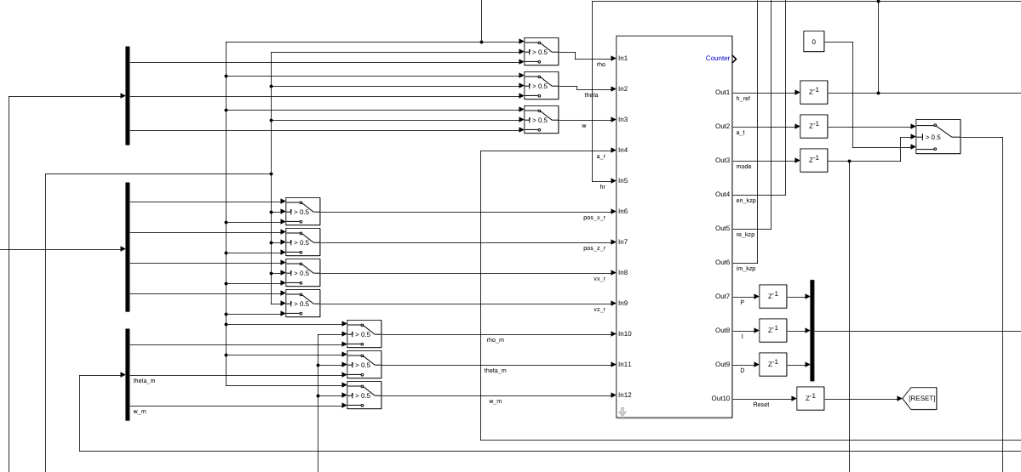
Simulink Model
Websocket Block
13. July 2018

Slide 4
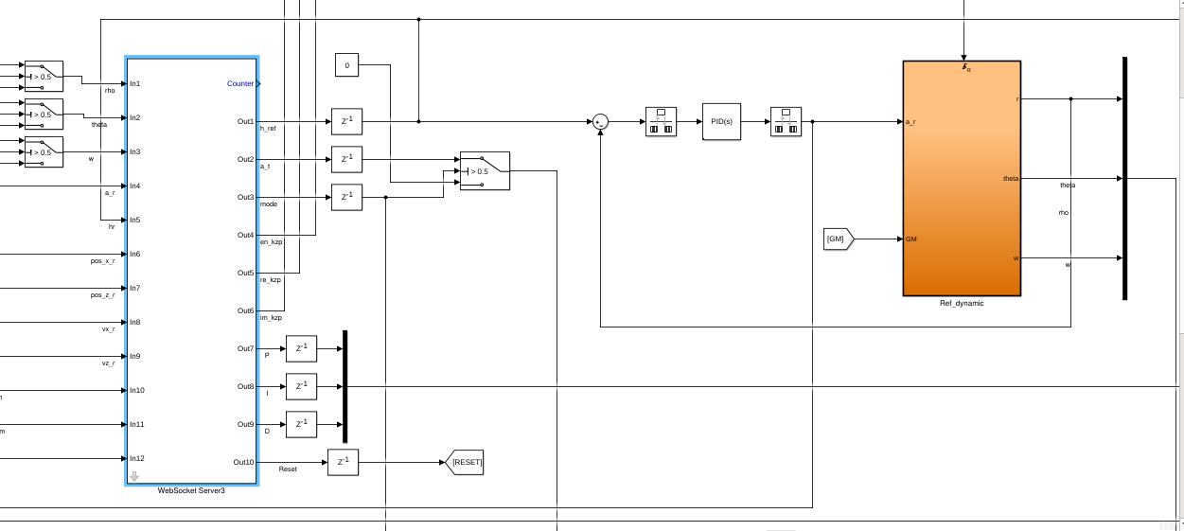
Simulink Model
Satellite dynamics model
13. July 2018

Slide 5
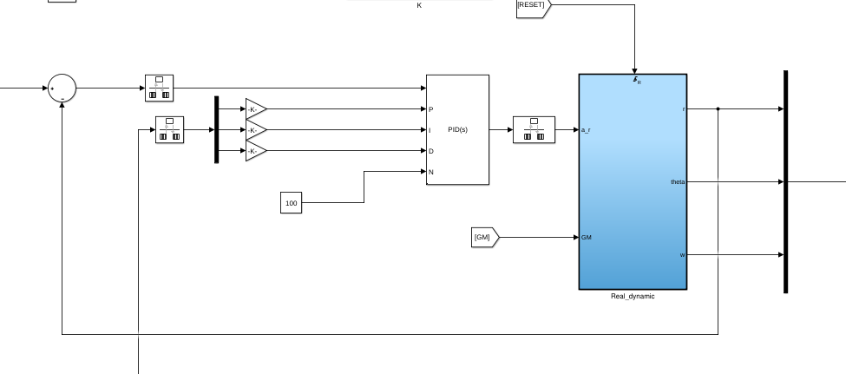
Simulink Model
Input as reference height of orbit
the Error
PID Controller
Output as height of satellite
Feedback
13. July 2018

Slide 6
Thanks for your listening !
13. July 2018

